Slide 1
INFERENCE · MULTI-TOKEN PREDICTION
Elucidating Inference in
Multi-Token Prediction
Proposal, Verification, Parallelization — and compute-latency trade-offs.

Slide 2
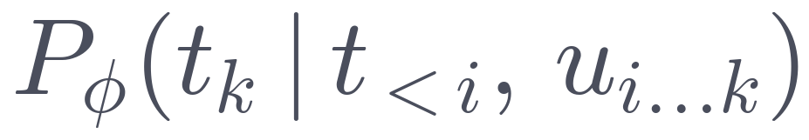
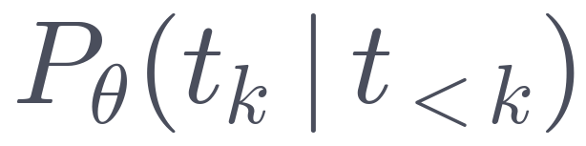
HOW MULTI-TOKEN PREDICTION WORKS
Many tokens per step.
predicted
1
Propose
def
factorial
(
n
]
:
several tokens
2
Verify
(
n
]
:
in parallel
✓
✓
✗
—
Correct
def
factorial
(
n
)
3 tokens committed this step
vs. 1 for autoregressive → speedup
3
first mistake
fix

Slide 3
SPEEDUP
PTP is the fastest model.
7B model, LoRA-trained on ShareGPT · speedup on SpecBench (Xia et al., 2024) · RTX 6000.
Autoregressive
Autoregressive Component
Independent Prediction
Uncoordinated Prediction

Slide 4
TOKENS / STEP
PTP finds the most tokens.
7B model, LoRA-trained on ShareGPT · tokens per step on SpecBench (Xia et al., 2024) · RTX 6000.
Autoregressive
Autoregressive Component
Independent Prediction
Uncoordinated Prediction

Slide 5
Research Question:
On a single GPU, what is the lowest latency we can achieve, that still produces high-quality outputs?

Slide 6
TOKENS / STEP
Can we do better?
We provide a complete recipe to get the most out of a pretrained model.

Slide 7
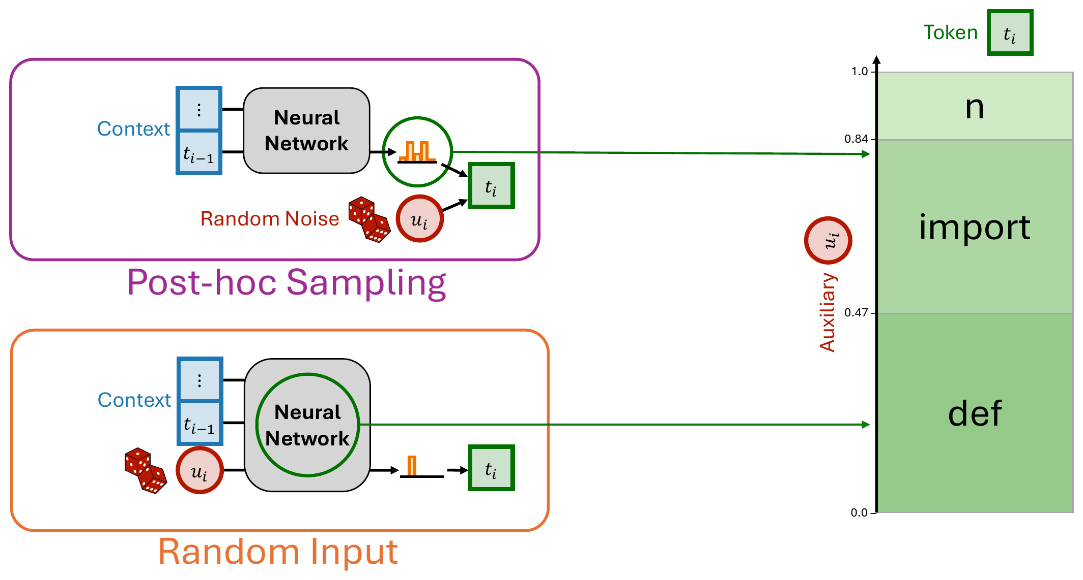
PARALLEL TOKEN PREDICTION
Auxiliaries characterize generated tokens.
For PTP as model input, for MTP as token selector.

Slide 8
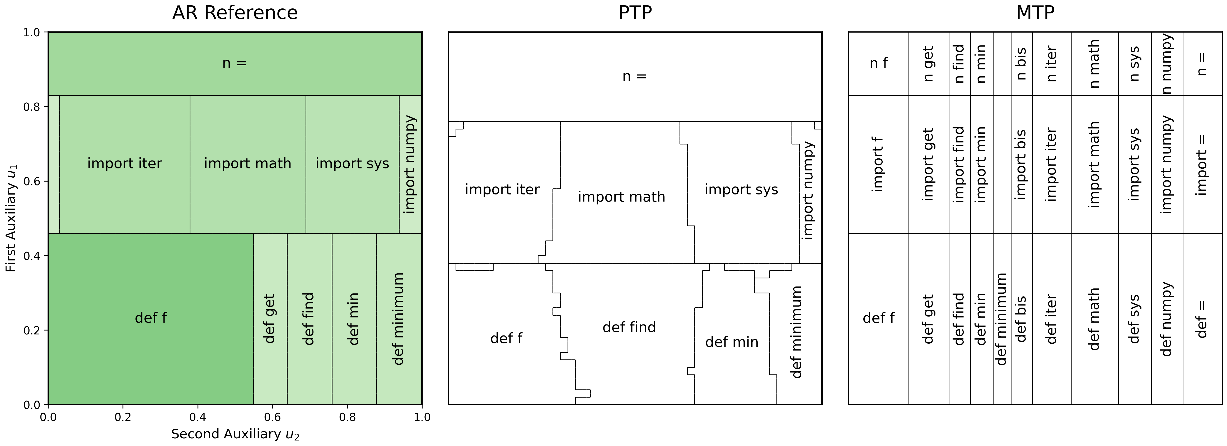
FAILURE MODES
Which mistakes does PTP make?
PTP defines correct tokens as identical to the reference model for the same auxiliaries, MTP usually as high AR likelihood.

Slide 9
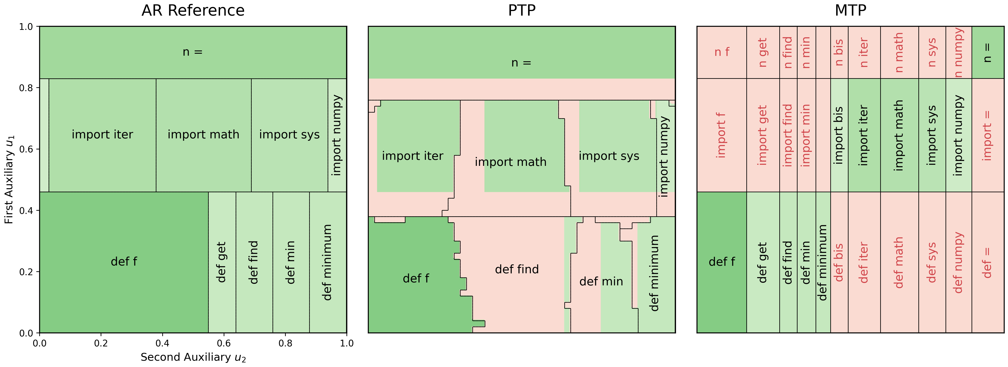
FAILURE MODES
Which mistakes does PTP make?
PTP defines correct tokens as identical to the reference model for the same auxiliaries, MTP usually as high AR likelihood.
63%
39%

Slide 10
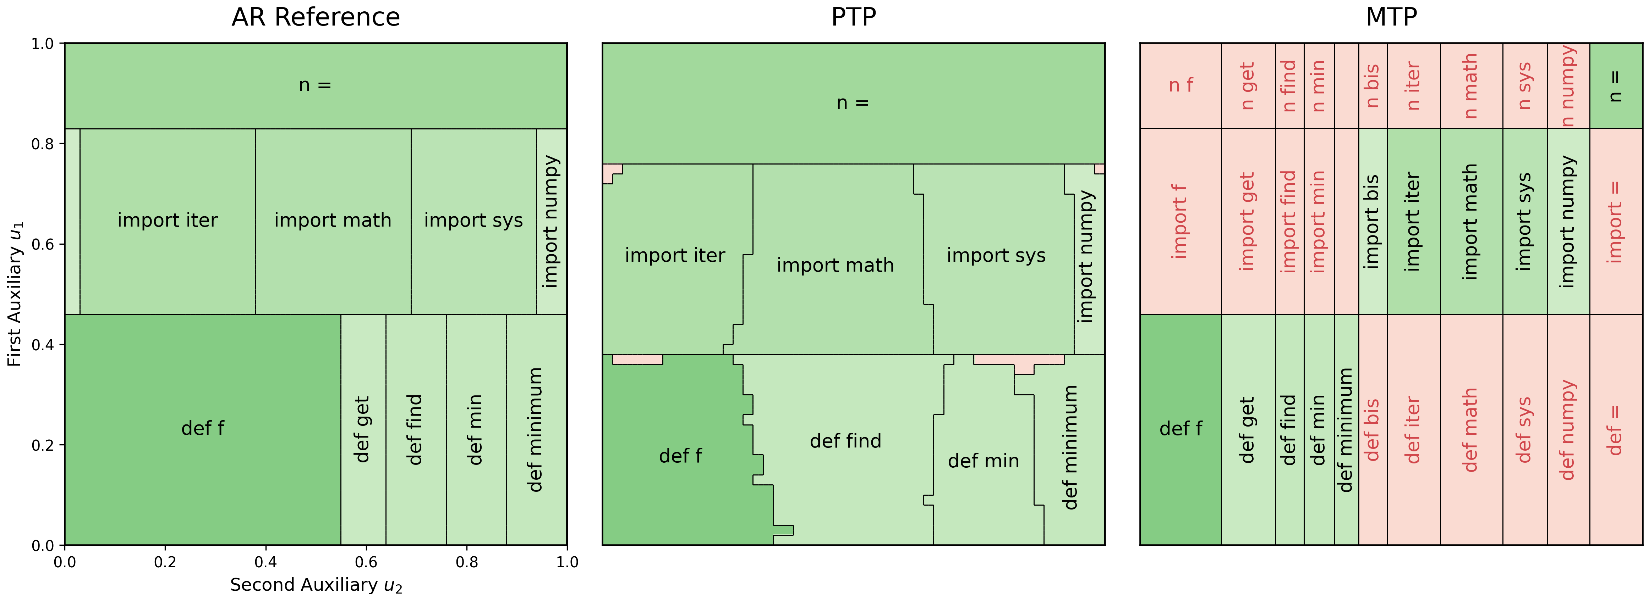
FAILURE MODES
Use a broader verification criterion.
This biases output but retains high quality in practice.
99%
39%

Slide 11
TOKENS / STEP
Use a broader verification criterion.
This biases output but retains high quality in practice.
+18%

Slide 12
FAILURE MODES
Take more chances.
Takes more compute, improves latency, no strong bias in practice.
predicted
1
Propose
def
factorial
(
num
]
:
several strands
(
n
]
:
(
n
)
:
2
Verify
(
num
]
:
in parallel
(
n
]
:
(
n
)
:

Slide 13



FAILURE MODES
Take more chances.
Takes more compute, improves latency, no strong bias in practice.
39%
$$1−(1−39\%)^{2}=63\%$$
× 50
$$1−(1−39\%)^{50}=100\%$$
99%
39%

Slide 14
TOKENS / STEP
Take more chances.
Takes more compute, improves latency, no strong bias in practice.
+10%
+18%

Slide 15

EFFICIENCY
Take more efficient chances.
Calibrate number and size of proposals, context-specific.
(
num
]
:
× 3
(
n
]
:
(
n
)
:
(
num
× 2
× 1
(
n
]
:
(
n
)
:
× 1
× 2
(
num
(
n
(
n
)
:

Slide 16

EFFICIENCY
Take more efficient chances.
Calibrate number and size of proposals, context-specific.
$W_{d}$: width at depth $d$
easy:
summarization, translation
× 50
medium:
coding, structured text
× 25
× 75
hard:
arbitrary text
× 5
× 135
depth

Slide 17




EFFICIENCY
Take more efficient chances.
Calibrate number and size of proposals, context-specific.
Given a node budget K, which allocation
$$W_{d}∈ℕ^{20},\sum_{d}{W_{d}=K}$$
is optimal w.r.t. number of correct tokens
$$E(\#correct|W_{d}, t_{<i})$$
1
Model $P(\#correct=c)$
Geometric Distribution.
2
Model $P\left(\#correct=c \right|W_{d})$
Zero-inflated BetaBinomial branching process.
3
Model $P\left(\#correct=c \right|W_{d},t_{<i})$
Bayesian updates, Small output heads.

Slide 18
TOKENS / STEP
Take more efficient chances.
Calibrate number and size of proposals, context-specific.
+10%
+4%
+18%

Slide 19
ALIGNMENT
Use a better aligned AR reference.
Instead of separate teacher weights $P_{θ}\left(t_{k}\right|t_{<k})$ use aligned student weights $P_{φ}\left(t_{k}\right|t_{<k})\text{.}$
predicted
1
Propose
def
factorial
(
n
]
:
several tokens
2
Verify
(
n
]
:
in parallel
✓
✓
✗
—
Correct
def
factorial
(
n
)
3 tokens committed this step
vs. 1 for autoregressive → speedup
3
first mistake
fix

Slide 20
TOKENS / STEP
Use a better aligned AR reference.
Instead of separate teacher weights $P_{θ}\left(t_{k}\right|t_{<k})$ use aligned student weights $P_{φ}\left(t_{k}\right|t_{<k})\text{.}$
+22%
+10%
+4%
+18%

Slide 21
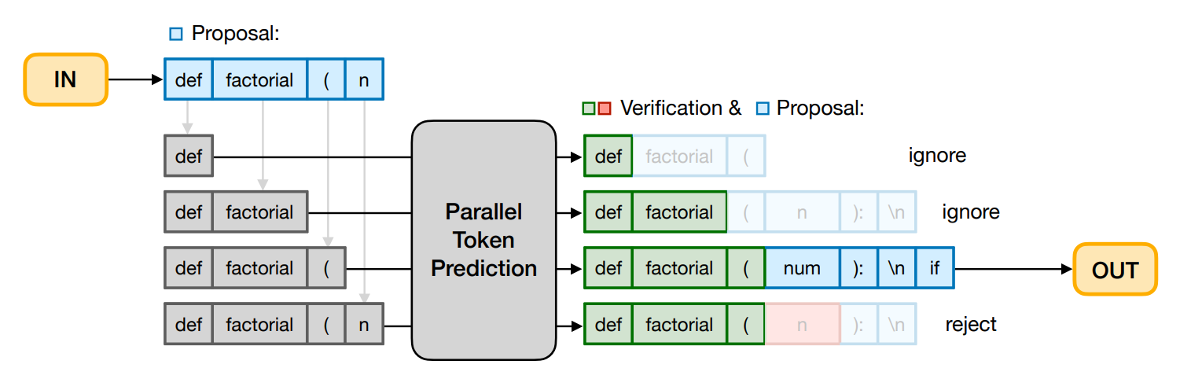
EFFICIENCY
Parallelize proposal and verification.
Partial Quadratic Decoding keeps extra compute limited$\text{.}$

Slide 22
TOKENS / STEP
Parallelize proposal and verification.
Partial Quadratic Decoding keeps extra compute limited$\text{.}$
+40-80%
+22%
+10%
+4%
+18%

Slide 23
TOKENS / STEP
Combining all techniques leapfrogs baselines.
7B model, LoRA-trained on ShareGPT · tokens per step on SpecBench (Xia et al., 2024) · RTX 6000.
Autoregressive
Autoregressive Component
Independent Prediction
Uncoordinated Prediction

Slide 24
QUALITY
Some examples.
Compose an engaging travel blog post about a recent trip to Hawaii, highlighting cultural experiences and must-see attractions.
Title: Discovering the Beauty of Hawaii: A Cultural Journey
Introduction:
Hawaii, a tropical paradise located in the Pacific Ocean, has been a dream destination for many. The archipelago is known for its stunning beaches, lush rainforests, and rich cultural heritage. In this blog post, we'll explore the cultural experiences and must-see attractions that made our recent trip to Hawaii an unforgettable adventure.
Day 1: Oahu
- Visited the USS Arizona Memorial at Pearl Harbor, a solemn reminder of the sacrifices made during World War II.
- Explored the Polynesian Cultural Center, where we witnessed traditional dances and learned about the unique cultures of different islands in the Pacific.
- Enjoyed a delicious luau dinner, complete with authentic Hawaiian cuisine and live music.
Day 2: Maui
- Took a scenic drive through the island's lush landscapes, including the famous Haleakala National Park.
- Visited the Makalii Center, where we learned about the history and culture of the Maui people.
- Relaxed on the beach and snorkeling in the crystal-clear waters to see the colorful fish and coral reefs.
Day 3: Big Island
- Took a tour of the Hawaii Volcanoes National Park, where we saw the Kilauea Volcano and the Steam Vent.
- Visited the Hapuna Beach, a picturesque beach with white sand and clear blue waters.
- Explored the Hawaiian Royal Gardens, where we learned about traditional Hawaiian plants and their uses.
Day 4: Kauai
- Took a scenic flight over the island, providing breathtaking views of the Na Pali Coastline.
- Visited the Hanalei Bay, a stunning beach with crystal-clear waters and lush greenery.

Slide 25
QUALITY
Some examples.
Write a C++ program to find the nth Fibonacci number using recursion.
#include <iostream>
using namespace std;
int fibonacci(int n) {
if (n == 0 || n == 1) return n;
return fibonacci(n-1) + fibonacci(n-2);
}
int main() {
int num;
cout << "Enter the number of Fibonacci numbers you want to find: ";
cin >> num;
cout << "Fibonacci numbers: ";
for (int i = 0; i < num; i++) {
cout << fibonacci(i) << " ";
}
return 0;
}

